Slide 1
Hyperbolic interpolation

Slide 2
Shader
Shader code
Vertex shader:
layout (location = 0) in vec3 position;
layout (location = 2) in vec2 texcoord;
out vec2 vs_fs_texcoord;
vs_fs_texcoord = texcoord;
gl_Position = projectionMatrix * viewMatrix * modelMatrix * vec4( position, 1.0);
Pixel shader:
in vec2 vs_fs_texcoord;
vec4 diffuse = texture(diffuseTex, vs_fs_texcoord)

Slide 3

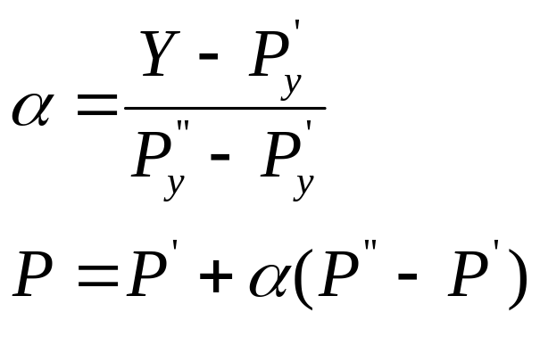




Under the hood
Z/position
  Linear Interpolation
  Example, for Y loop
  Effectively, the relation of Pz to pixel coordinates is of the form

Slide 4
Z/position interpolation
Why linear interpolation works?
  We start with a flat polygon in eye space, then put it through a weird perspective-distorting transform

Slide 5
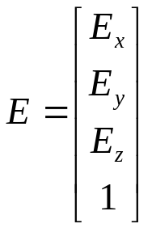



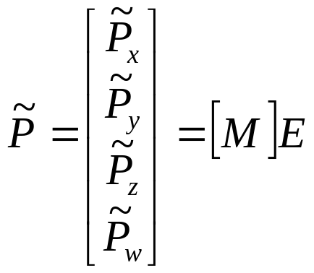


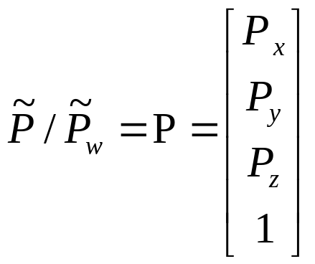
Transform between coordinate

Slide 6



proof
Let’s start with a point a distance along an edge
Transform it by M to get

Slide 7
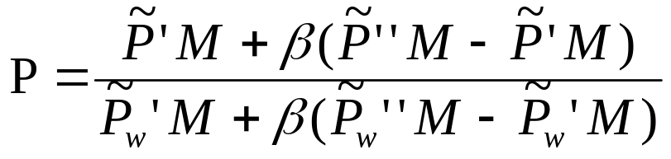
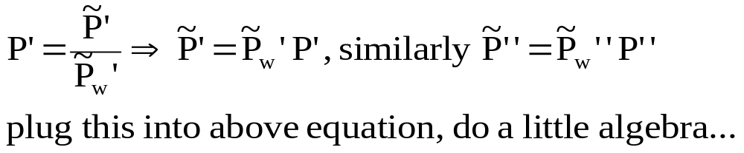
proof
Divide out the w component to get P
Write this in terms of the end points of the edge in pixel space

Slide 8
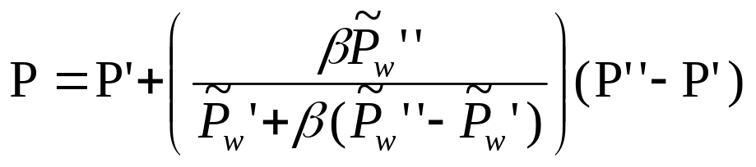

proof
We get
What does this mean?
  Compare this with linear interpolation in pixel space

Slide 9
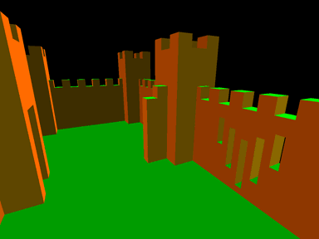
Side note
Z buffer/Z compression
Z is linear in pixel space
A couple notes about z
http://www.humus.name/index.php?ID=255
float dx = ddx(In.position.z);
float dy = ddy(In.position.z);
return 1000.0 * float4(abs(dx), abs(dy), 0, 0);

Slide 10
Hi-Z / Z compression
Works better if Z is linear in pixel space
  Don’t write eye space linear Z into Z buffer!!
Rasterizer/Pixel shader
8x8 uncompressed z-values
Updated z-values
Rough Z Tiles
Decompress
compress
Z Buffer

Slide 11

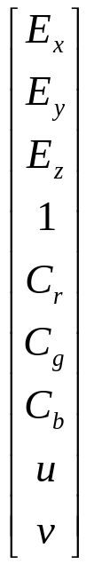
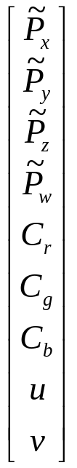
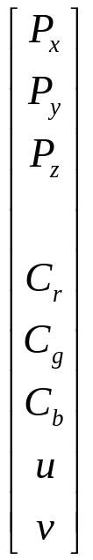
Rasterizer/interpolator
perspective transform
clipping
Divide by w
Interpolate
Eye space
Homogeneous space

Slide 12
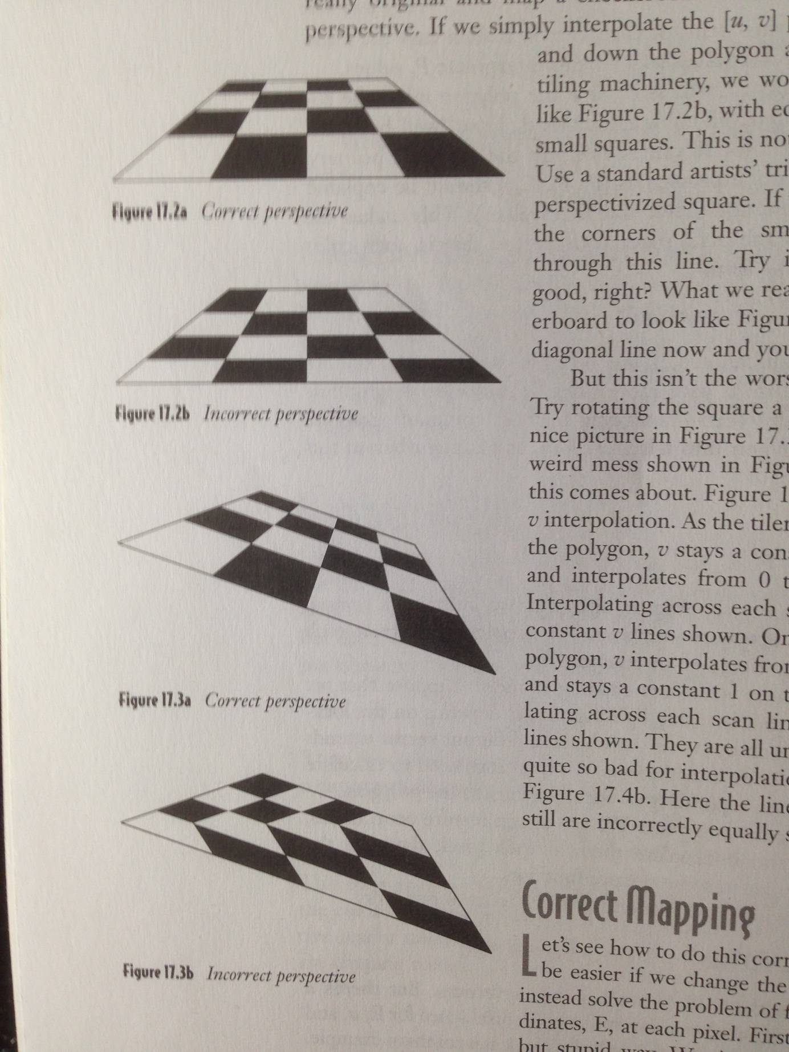
A problem of perspective
If we interpolate uv linearly in pixel space…

Slide 13
Correct mapping
Actually, we want interpolate uv linearly in eye space
Let’s solve the problem by finding eye space coordinates…

Slide 14
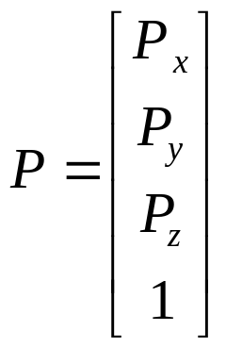
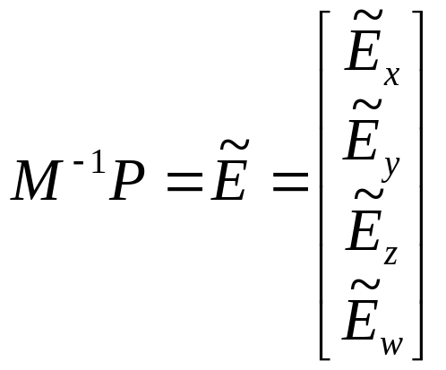
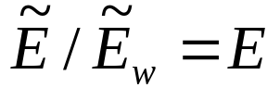
Correct mapping
At each pixel, we transform it by the inverse of M to get back to eye space

Slide 15

A faster way to be correct
Doing full matrix multiplication at each pixel is slow, and fortunately, unnecessary
look at the equation again
Remember that we are calculating the pixel space P by linear interpolating between end-points in pixel space
  We can factor the matrix multiplication out of the loop by linearly interpolating between values at its endpoints

Slide 16

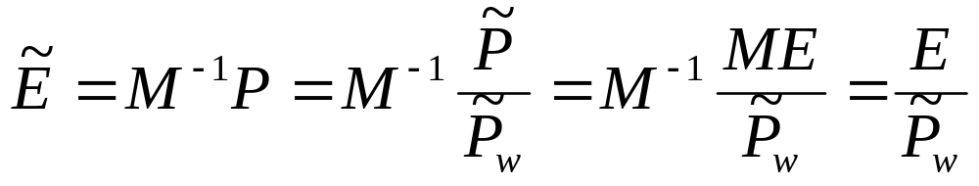

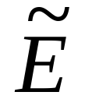
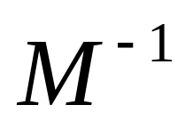
A faster way to be correct
In general, for any point

Slide 17
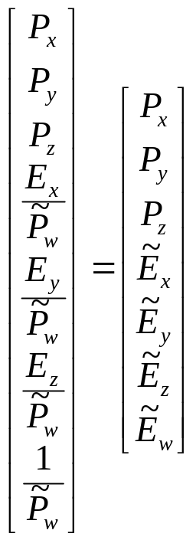



A faster way to be correct
So, to interpolate in eye space, we feed the interpolator
And after interpolation, divide by , we get

Slide 18
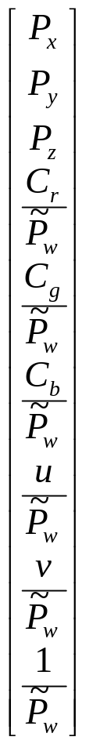

Perspective correct interpolation
perspective transform
clipping
Divide by w
Interpolate
Divide
By interpolated
Homogeneous space

Slide 19
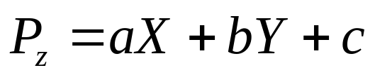
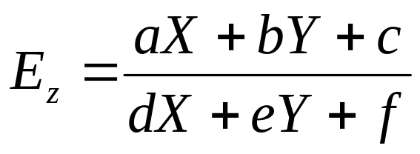
Hyperbolic interpolation
We interpolate Z linearly
We interpolate texture coord/color/other attributes hyperbolically since it is of the form

Slide 20
References
“Hyperbolic Interpolation”. Jim Blinn’s corner: A trip down the graphics pipeline, chapter 17

